Slide 1
IMAG Credible Practices Analysis for COVID-19 Models
Eric Davis
This research was supported by the ASKE program under
DARPA-PA-18-02-AIE-FP-039

Slide 2
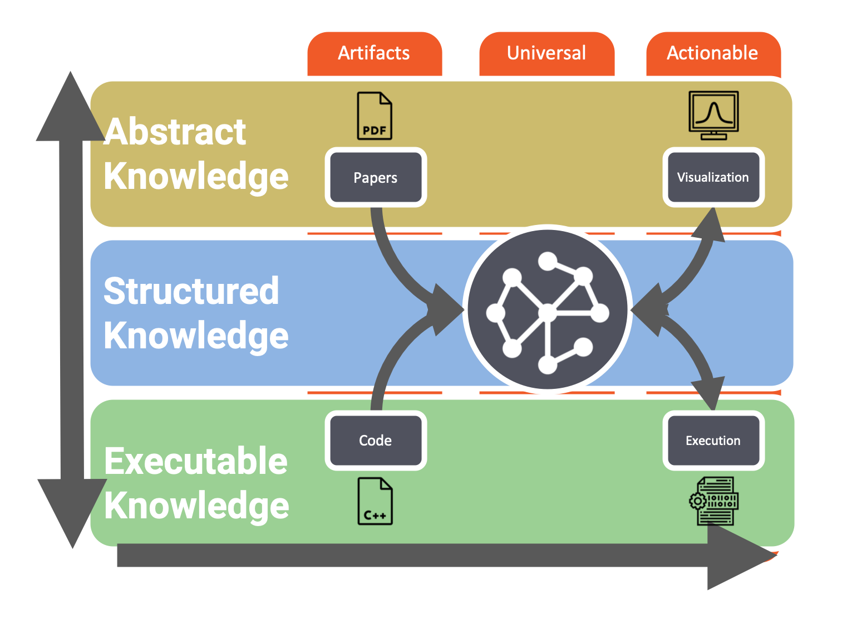
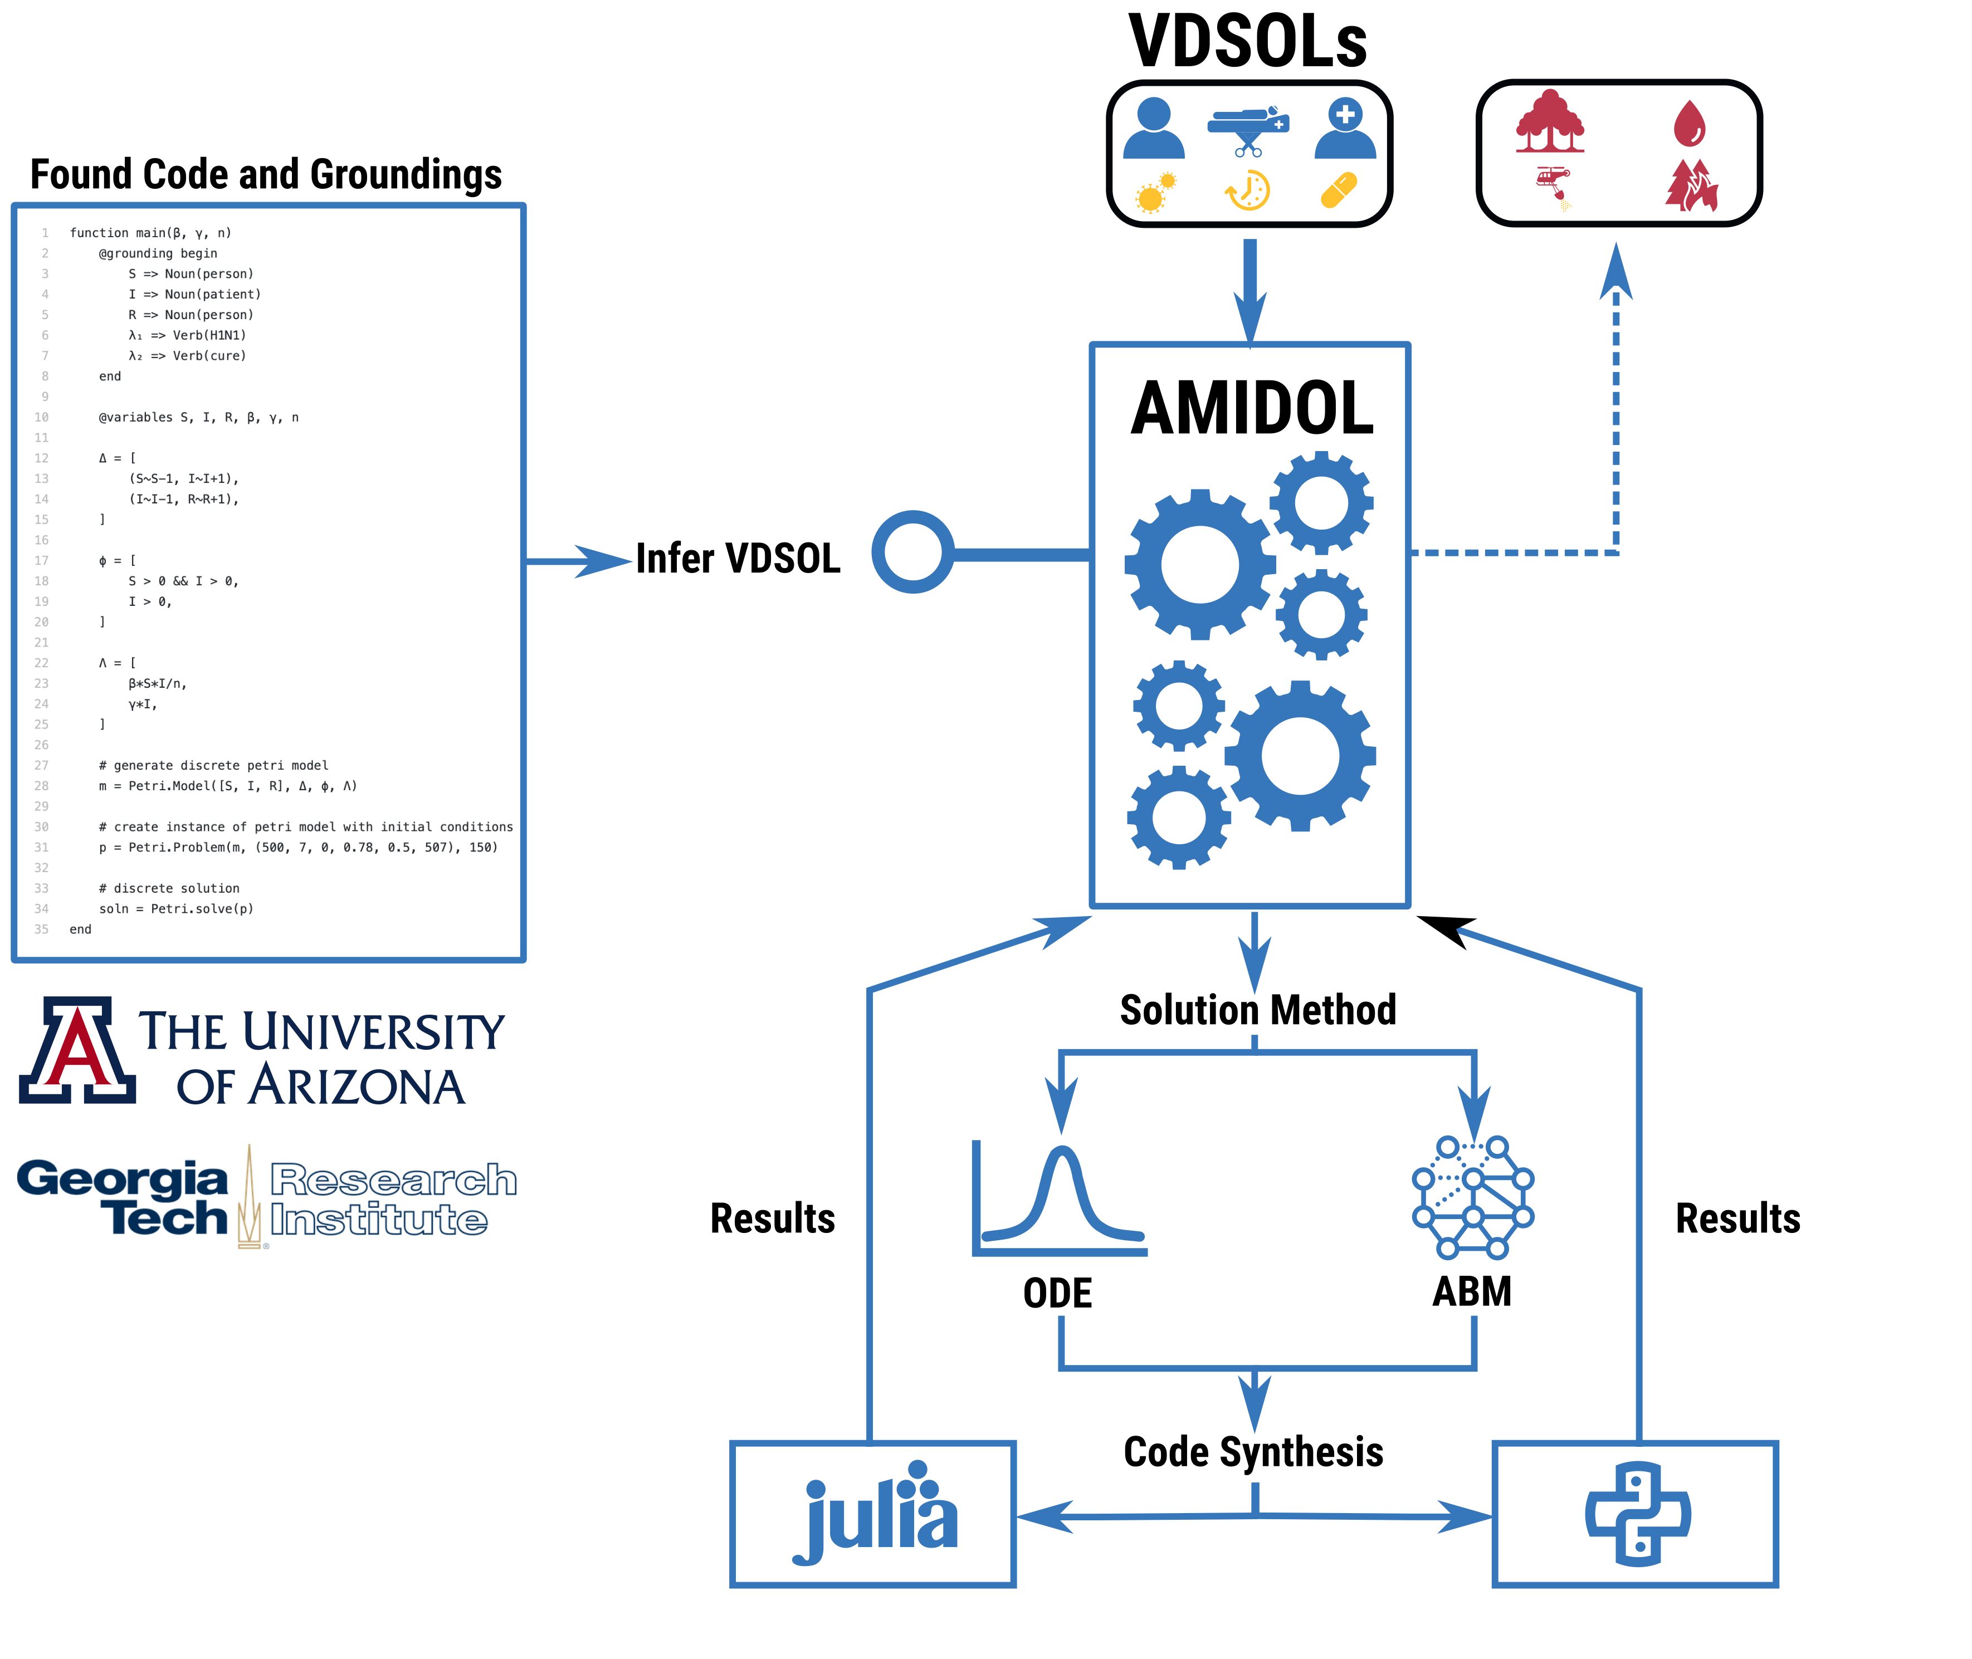
Model Credibility Analysis
Augmenting IMAG/CPMS Rules
Define context clearly
Use appropriate data
Evaluate within context
List limitations explicitly
Use version control
Document adequately
Disseminate broadly
Get independent reviews
Test competing implementations
Conform to standards

Slide 3
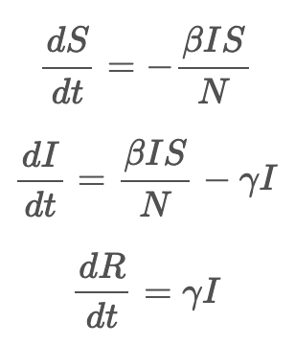
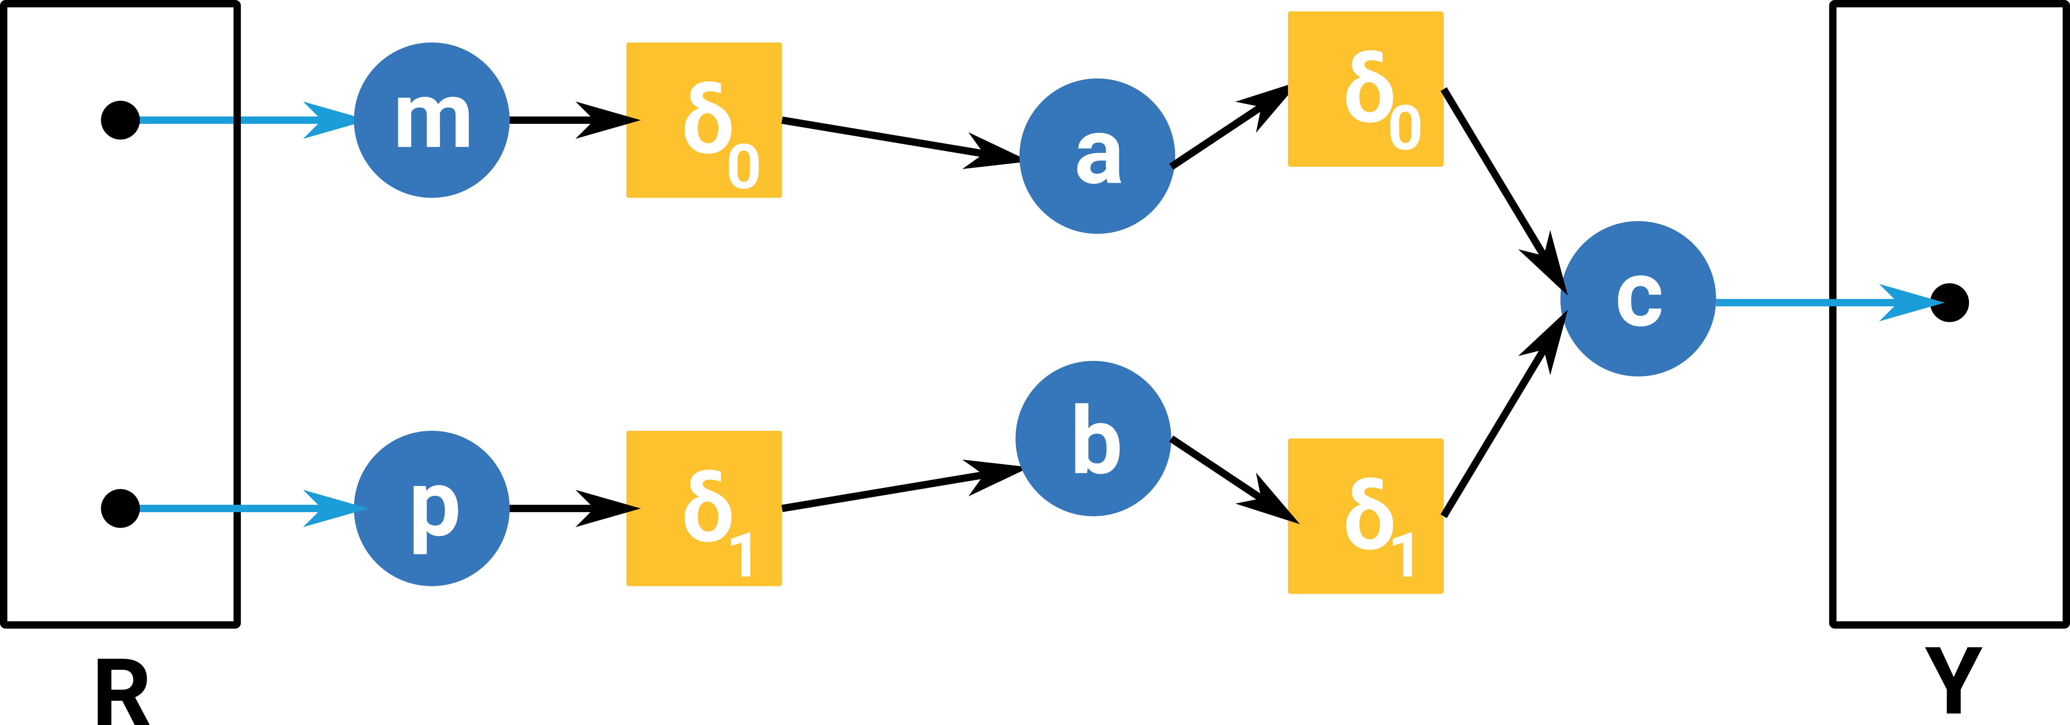
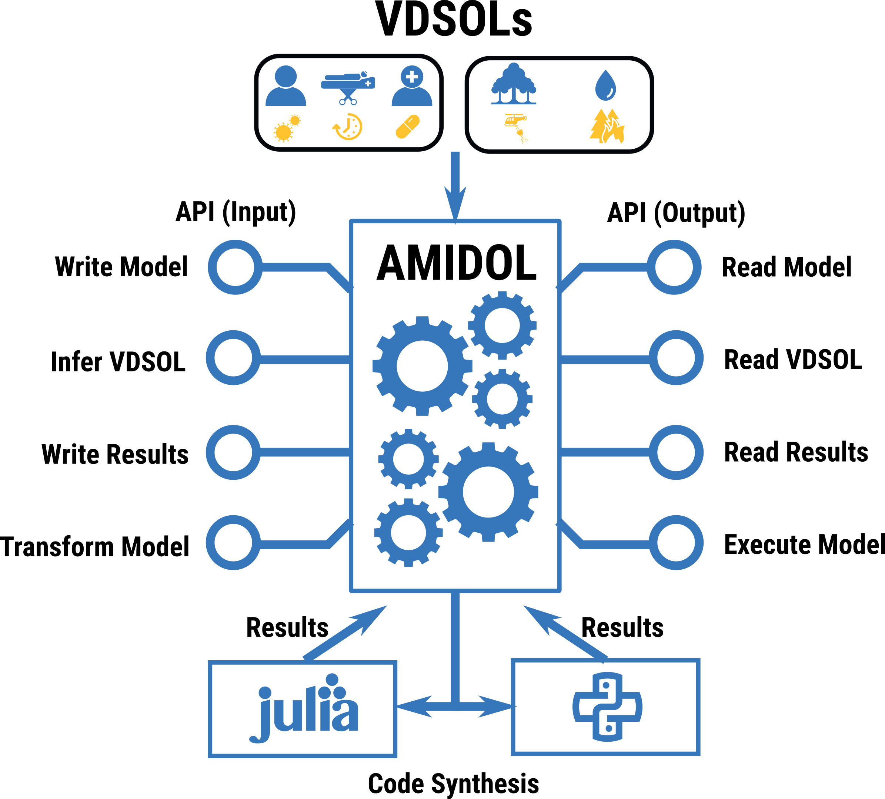
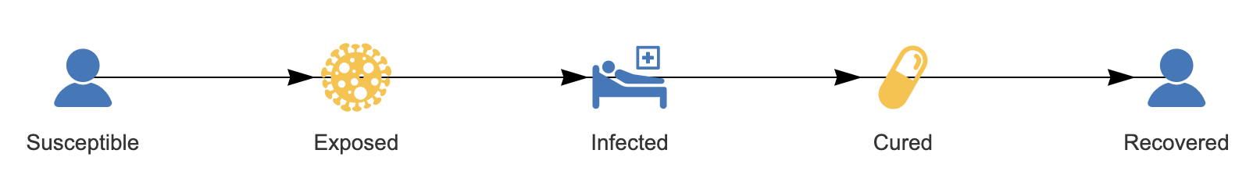
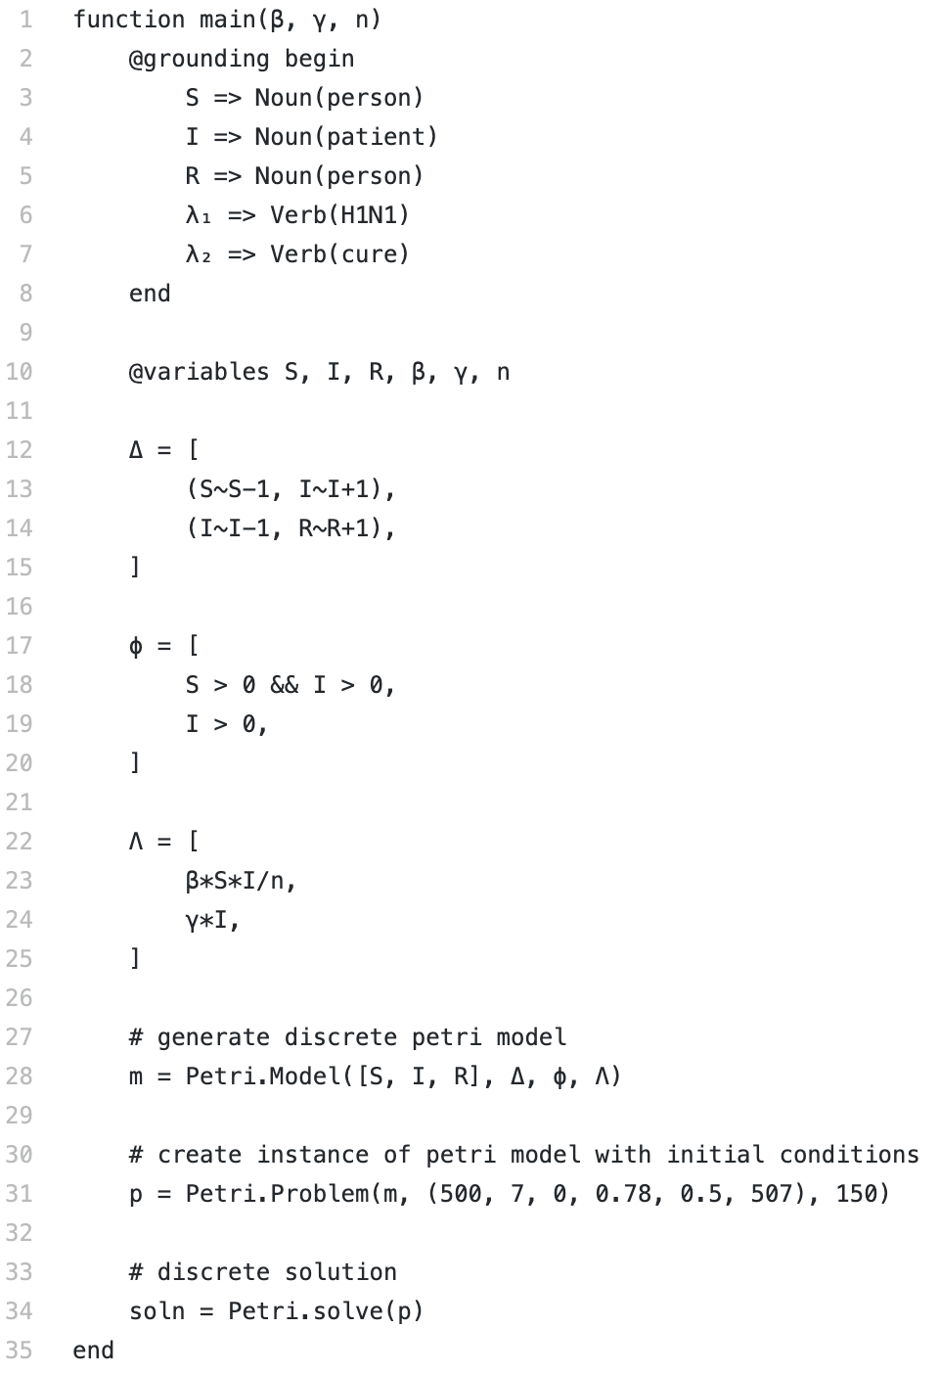
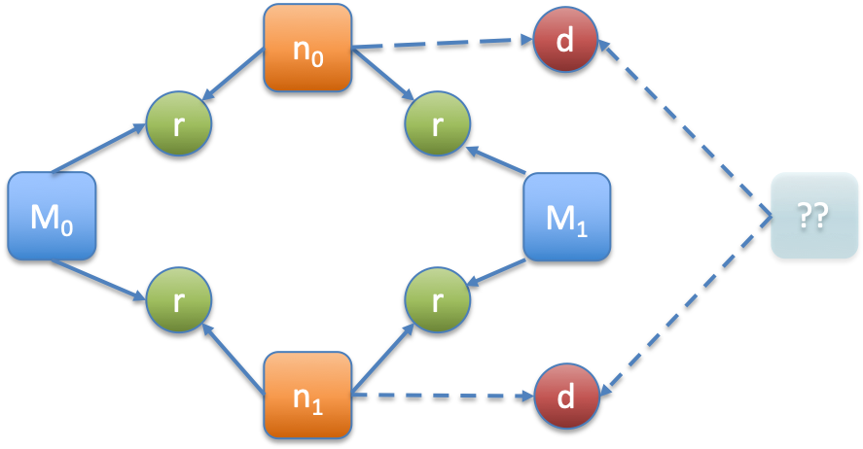
Rapid comparison of assumptions, credibility, and validity
Models developed for the COVID-19 pandemic are often bespoke, have undocumented assumptions, and are somewhat opaque to possible users. Wide proliferation of seemingly similar models with divergent outcomes have made model credibility and data-/model-driven policy development difficult. Models need to be understood, and adapted to local conditions and parameters to be of use to officials. Models need to be compared, inspected, validated, and assessed against each other and real data for fitness, and to develop trust and understanding. ASKE will enable this with automated methods to take models from a variety of sources, transform them into universal representations, and synthesize novel, high assurance versions which can be easily localized, automatically.
SIR Models – As Equations, Code, or Top-Down Developed
Extracted to Universal, and Comparable, Forms
ASKE: Model extraction, and novel code synthesis with correct-by-construction guarantees, comparability, and adaption for local differences.
Notes:
3. Data:
- How much data, what’s the quality, various assumptions. How are those expressed?
- Given the challenges of data, what can we say about these models and whether they’re useful and etc.
For aske2, promote within people using these models some formal notations that will allow these models to be extracted precisely and directly.

Slide 4
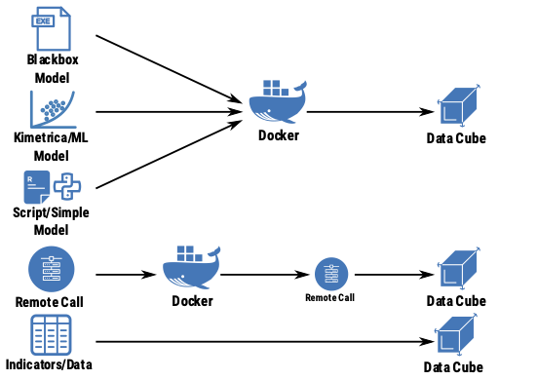
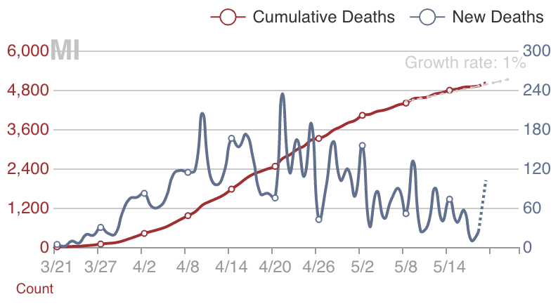
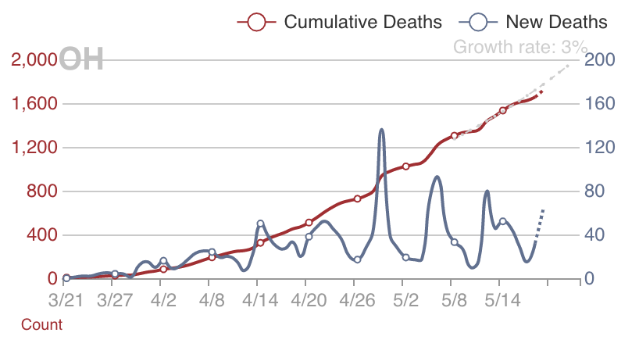
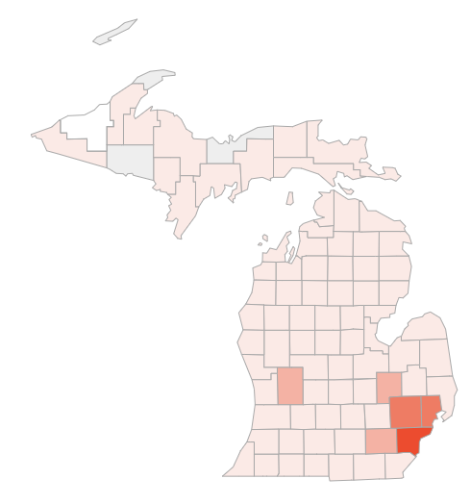
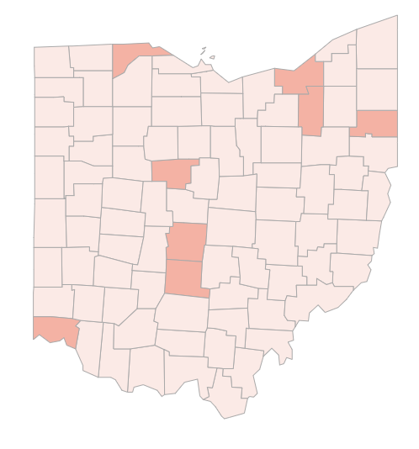
Exploring Model Spaces with AMIDOL
AMIDOL allows real-world data to be imported as a “first-class model”. Measure similarity can be easily established against candidate models, and the most predictive models for a given method can be identified using the AMIDOL results database, and measure algebraic comparisons.
Real data can also be used as comparative models to determine the impact of different policies and strategies, finding similar states, counties, or metro areas, and looking at the impact of policy on outcome.
n₀
d
r
r
M₀
M₁
??
r
r
n₁
d
Notes:
I don’t know if this is worth putting on the slide or just talking to it, but there is a nice story about adding features of the data into the model. When you go from SIR to SEIR you get the lag in initial time until peak infections correct (accuracy at small t), then when you go from SEIR to SEIRS you get the endemic equilibrium correct (accuracy at large t). These curves are drawn with the same biological parameters of the model taking the perspective that we are building physical models and not just doing curve fitting.

Slide 5
Comparing Models with Reality
Data can be treated as a first class model.
Only generates one realization for each data set.
Still a “predictive measure”.
Find other similar experiments.
Classify real world data sources by similarity.
Identify their differences in response
Reality vs. Reality comparison with data
Can a model explain the difference?
Source: https://coronavirus.1point3acres.com/en

Slide 6
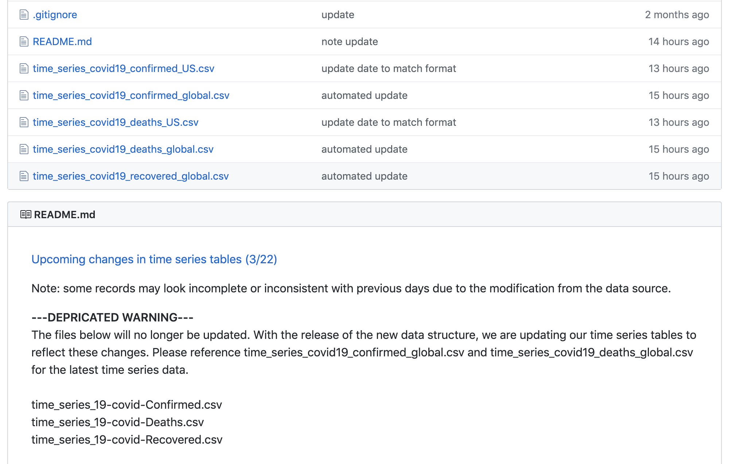
Agile Comparison during Crisis
Data sources often shift their publication method, schema and format.
Advance the state of the art by enabling agile transformations for comparisons of models with reality and adapt when data sources shift their standards.

Slide 7
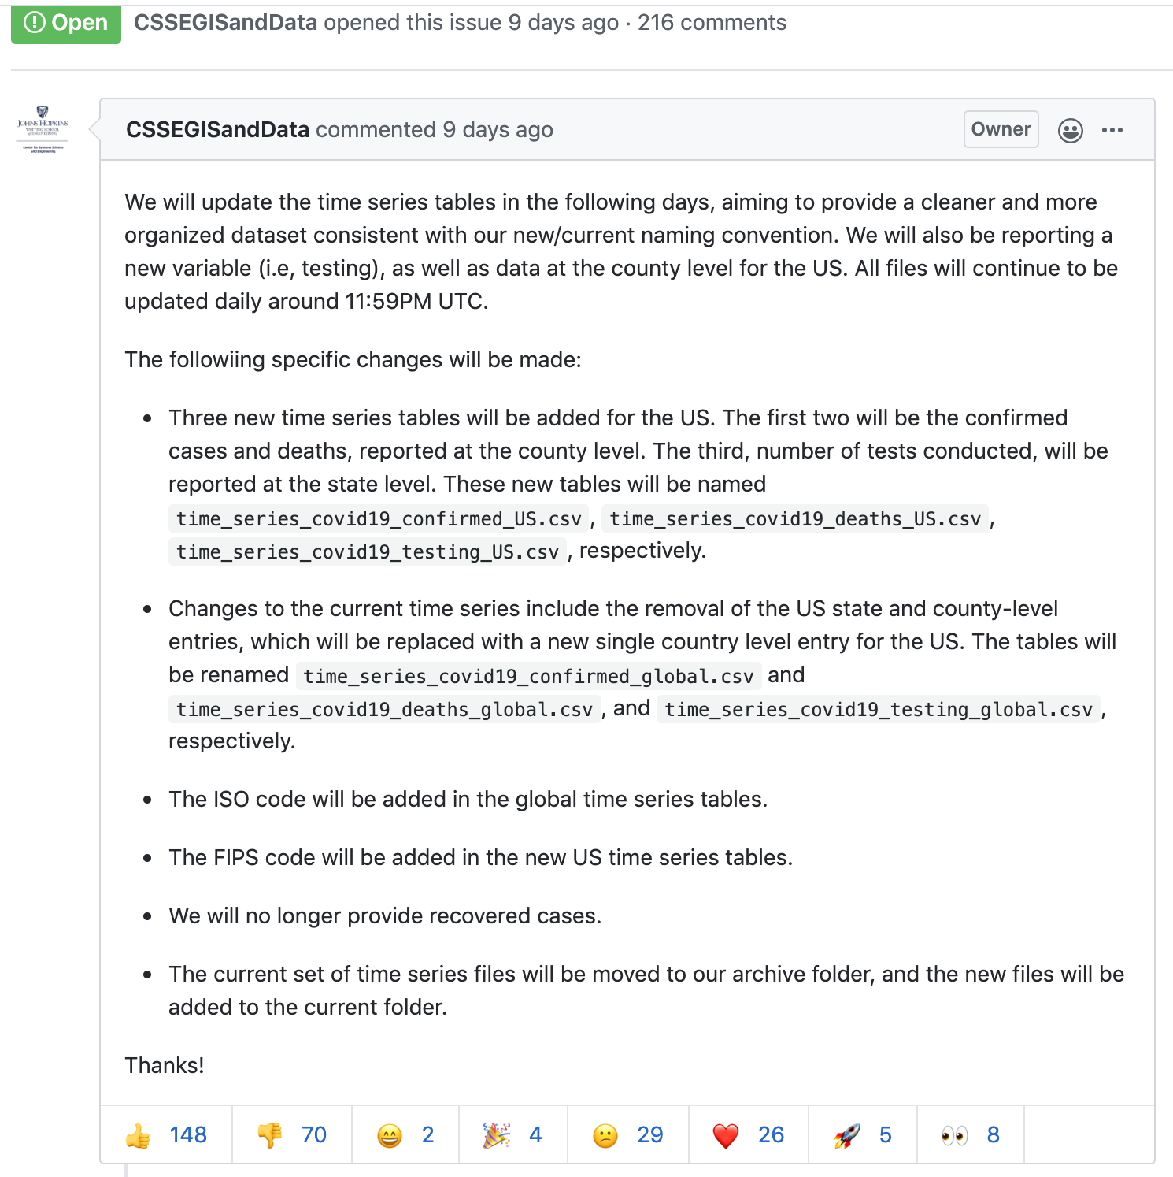
The Importance of Transforms for Agile Response
Adapting data sources with transforms to keep models from breaking.
Modeling as a Service
MaaS (WM) – building model pipelines.
AMIDOL as a model factory can help build these pipelines.
Rapidly debug pipeline failures.
Generate pipeline “patches” in response to changes when modeling during a crisis.

Slide 8
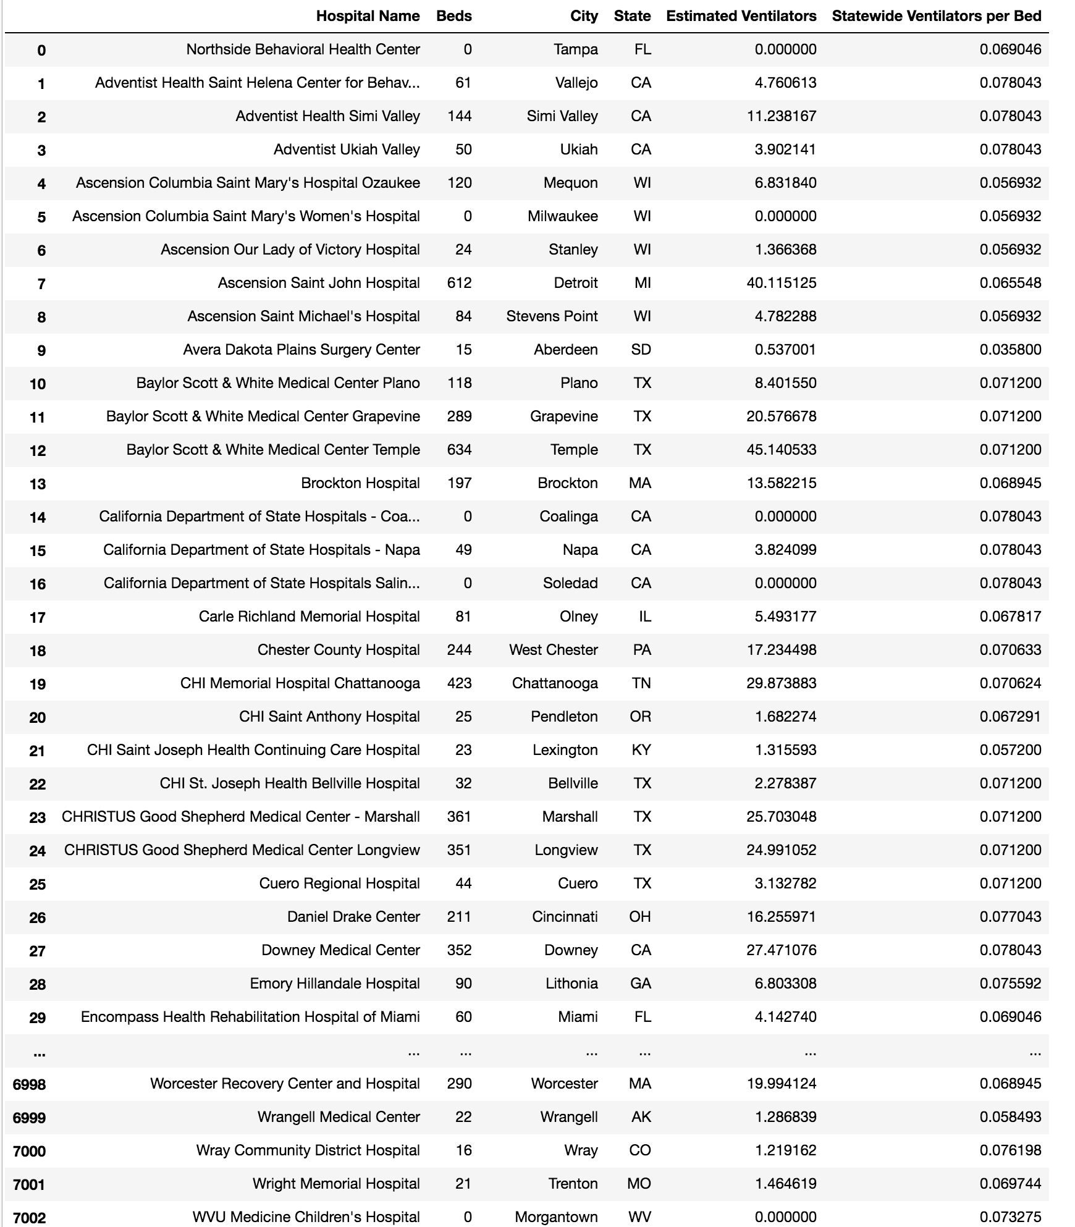
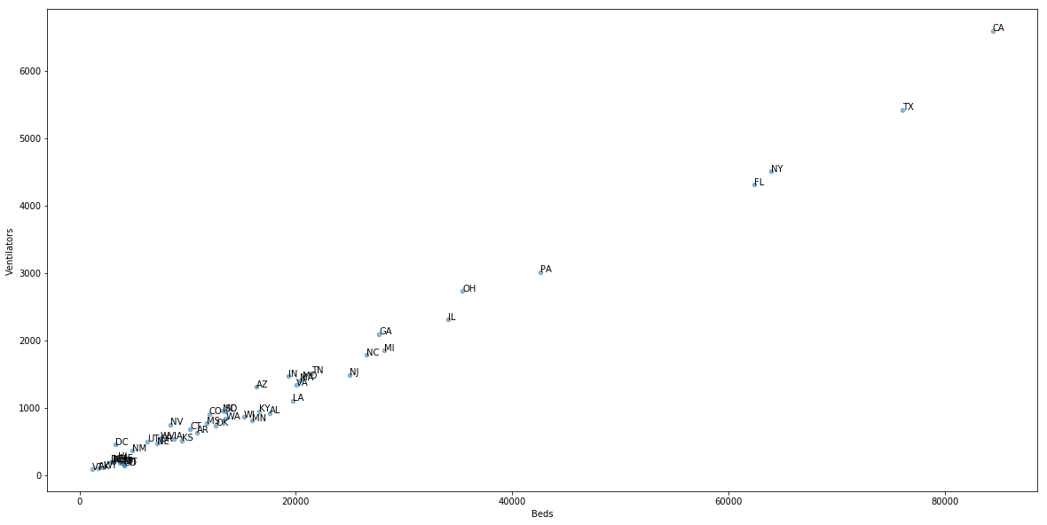
Data Transforms and Models
Use of data as an empirical model to fill in gaps in understanding for interventions and model development.

Slide 9
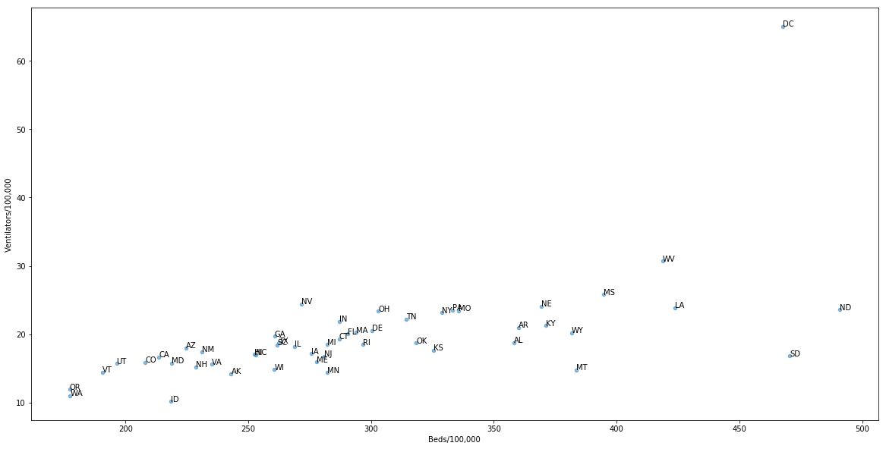
Improved Analysis to Understand Model Impact
Data can help us as a model of vulnerability and impact.
In response to COVID-19, we used real world data on hospital bed and ventilator availability to understand state readiness for the crisis, and to align models with expectations in the field.

Slide 10
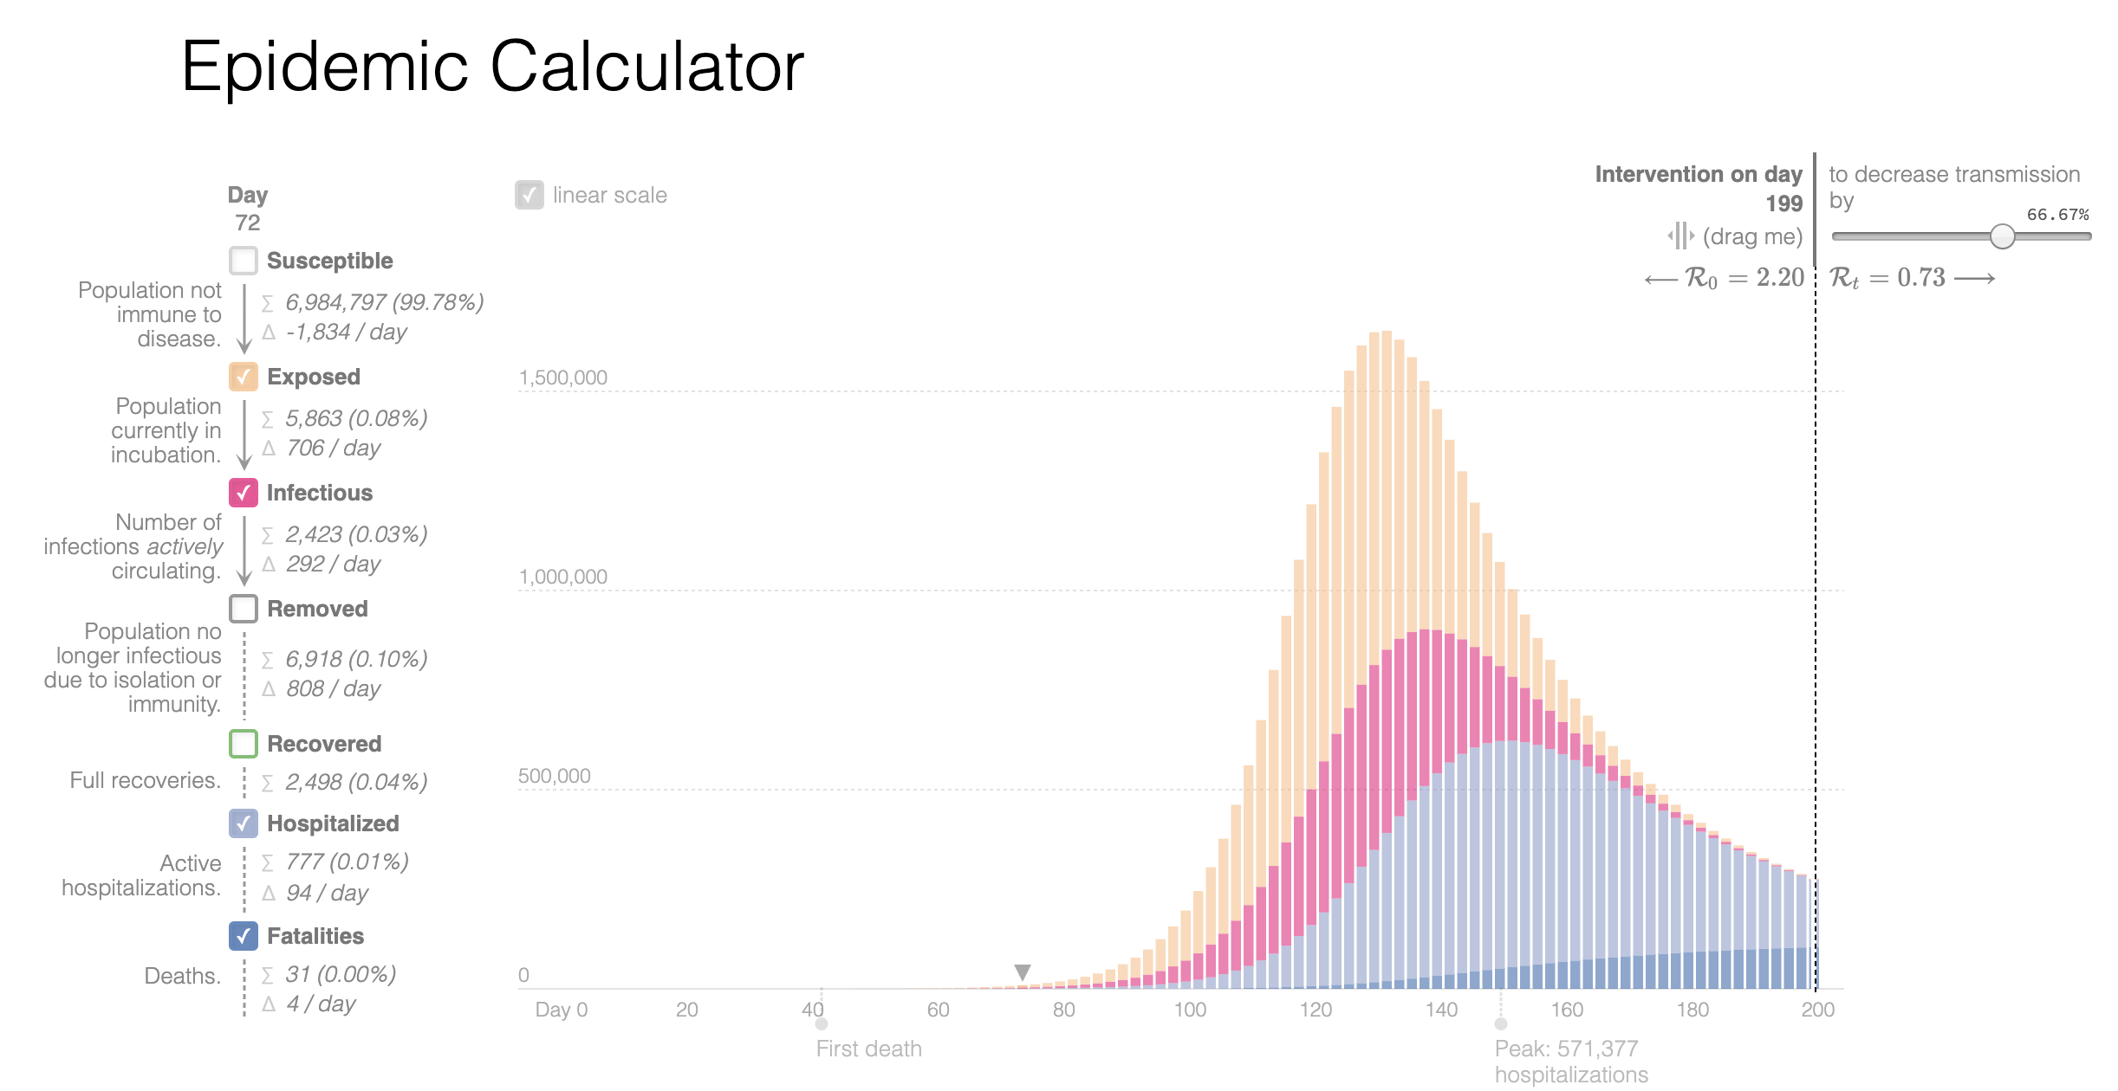
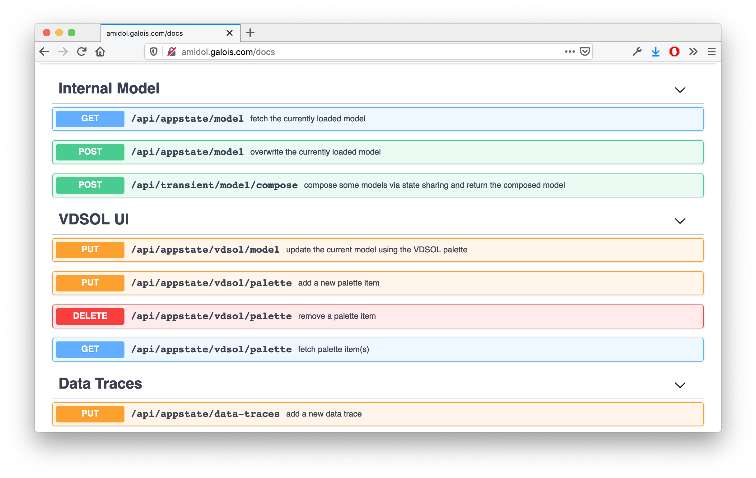

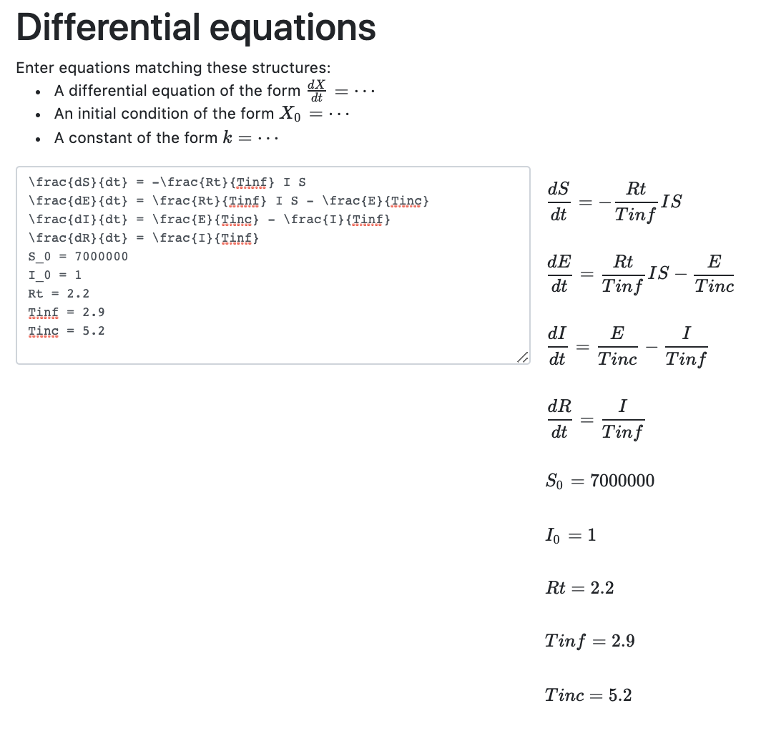
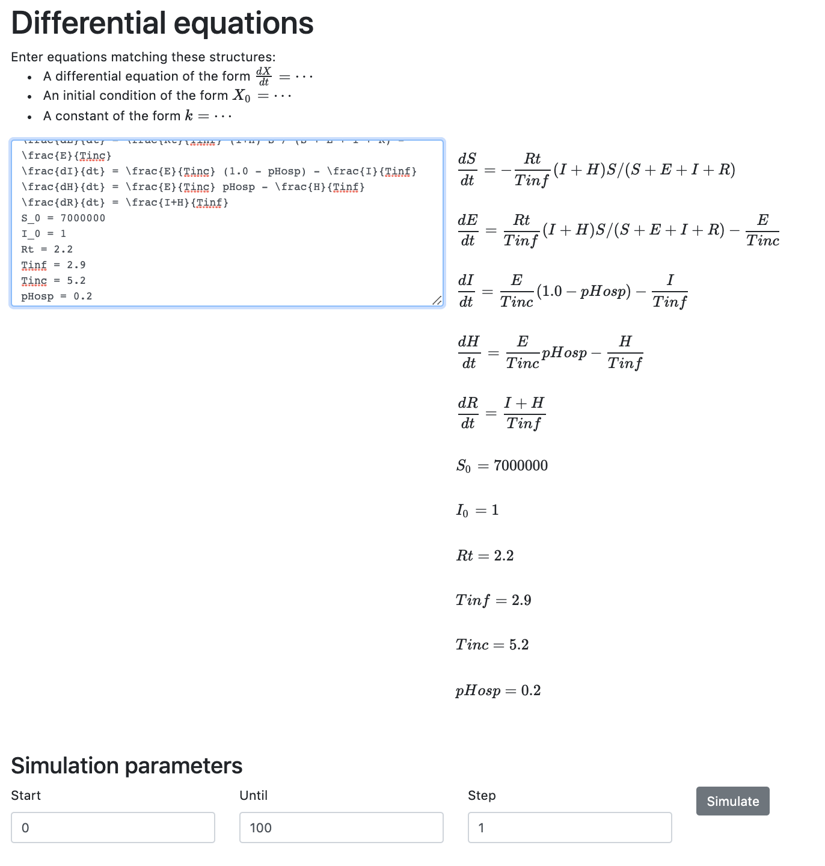
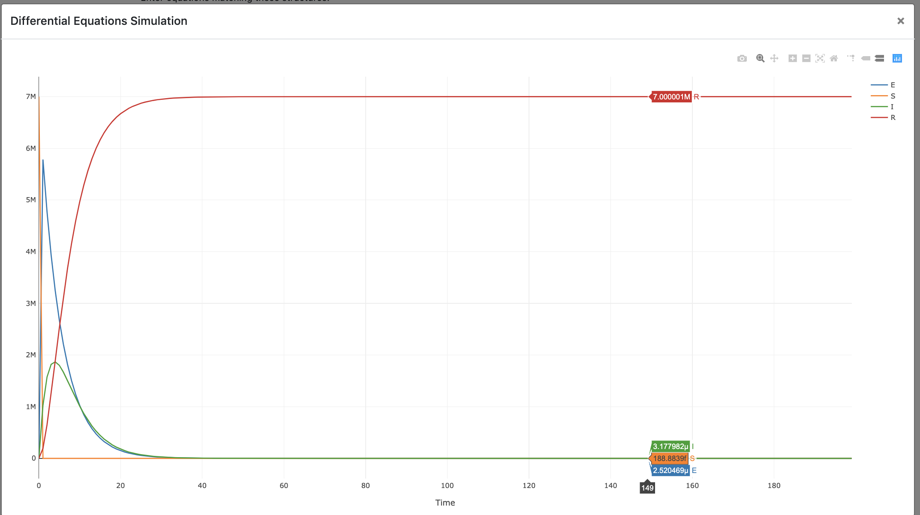
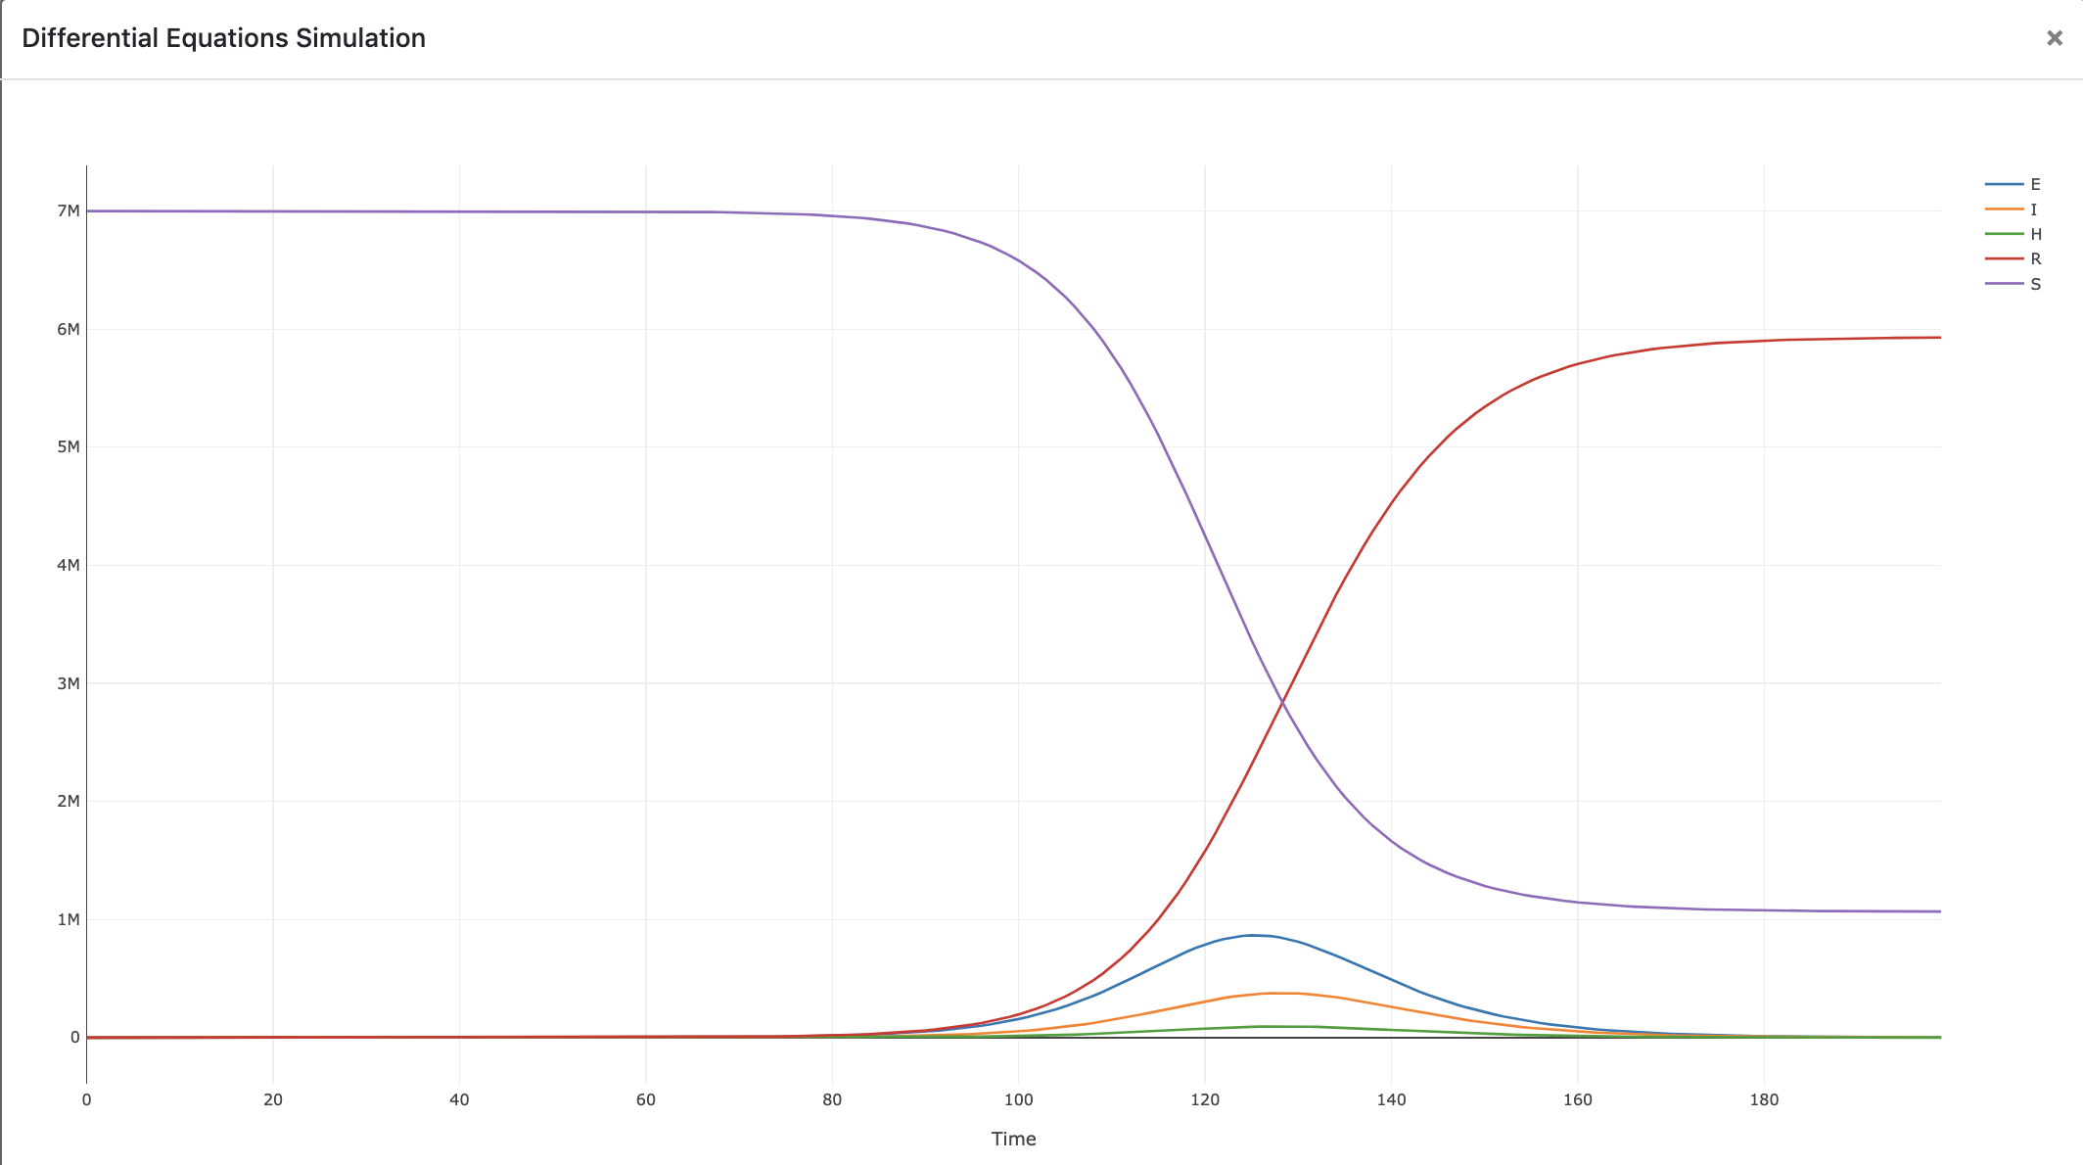
Extracting/exposing/verifing/comparing the structure and assumptions of models?
Answer: AMIDOL can synthesize models from code, equations, and diagrams, translating artifacts into universal representations, and testing assumptions. Model assumptions can be checked, and models can be
compared on the basis of measure similarity, structure, predictive power,
etc.
- High confidence models.
- Adapted for local concerns.
- Low effort model development, validation, and code synthesis.
APIs are exposed to allow AMIDOL to be used as a service, and to integrate deeply with existing tools and ecosystems.
Gabriel Goh’s SEIR Model
AMIDOL Synthesized Model doesn’t match the reported results.
AMIDOL identifies missing term, synthesizes correct model which matches reported results.
Notes:
2. Model extraction and comparison:
When you’re extracting models, how do you know that you’re doing well? What are the differences among models and how are they handled? Give a hint of this. Just an example.

